Slide 1

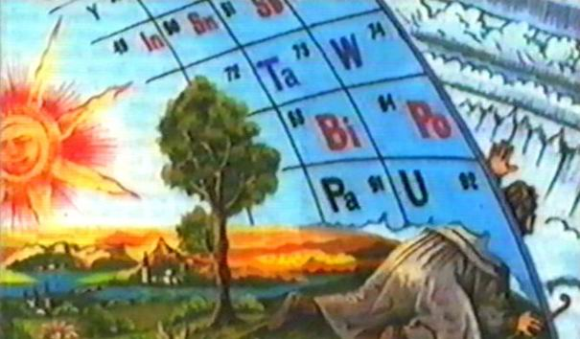
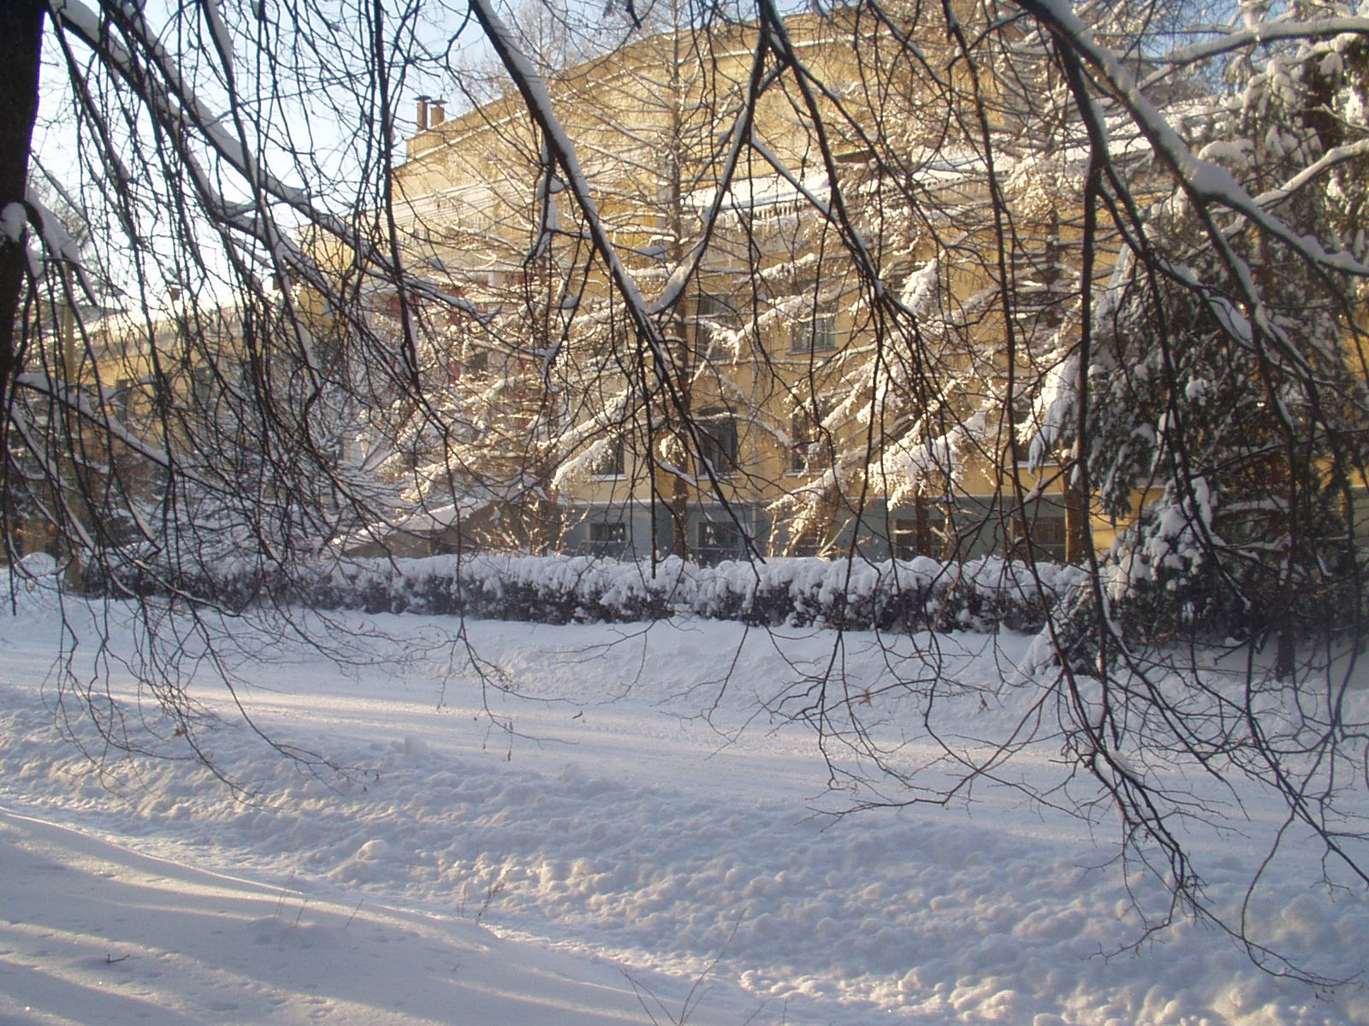
The current status of “masha” setup
Krupa L.
Flerov Laboratiory of Nuclear Reactions, JINR, Dubna, Russia

Slide 2
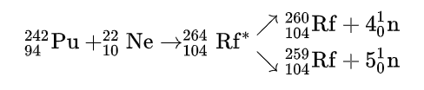
Elements obtained in Dubna first
¹⁸O + ²⁴³Am→²⁶¹Lr* →²⁵⁶Lr + 5n
²⁴⁹Cf+ ¹⁵N → ²⁶⁴Db* → ²⁶⁰Db + 4n
²⁴⁹Cf + ¹⁸O→²⁶³Sg + 4n
Cn… Nh, Fl, Mc, Ts, Og.
To be continued…

Slide 3
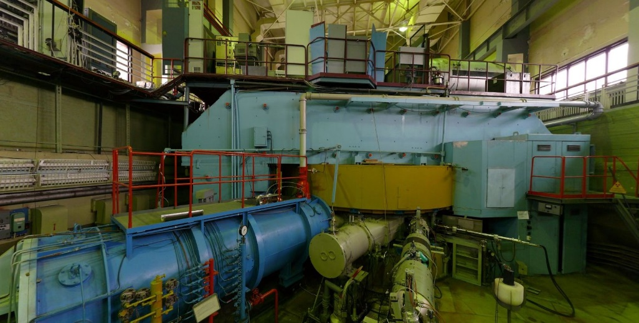
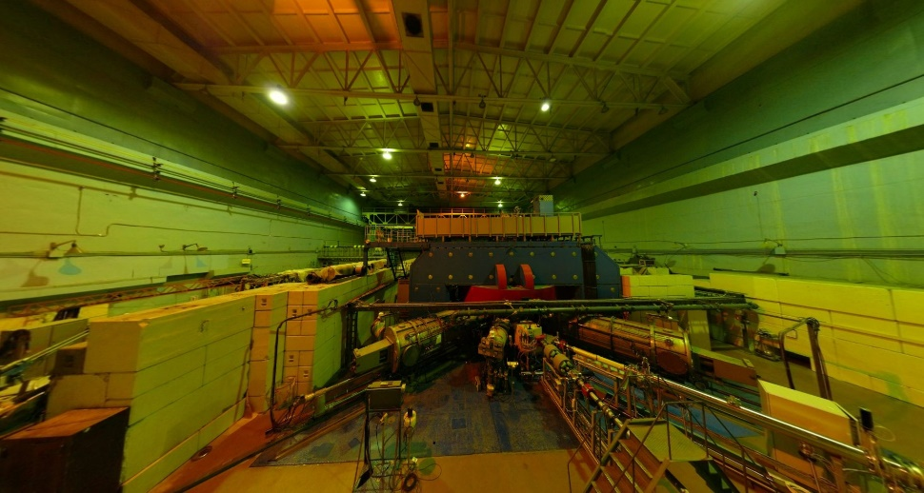
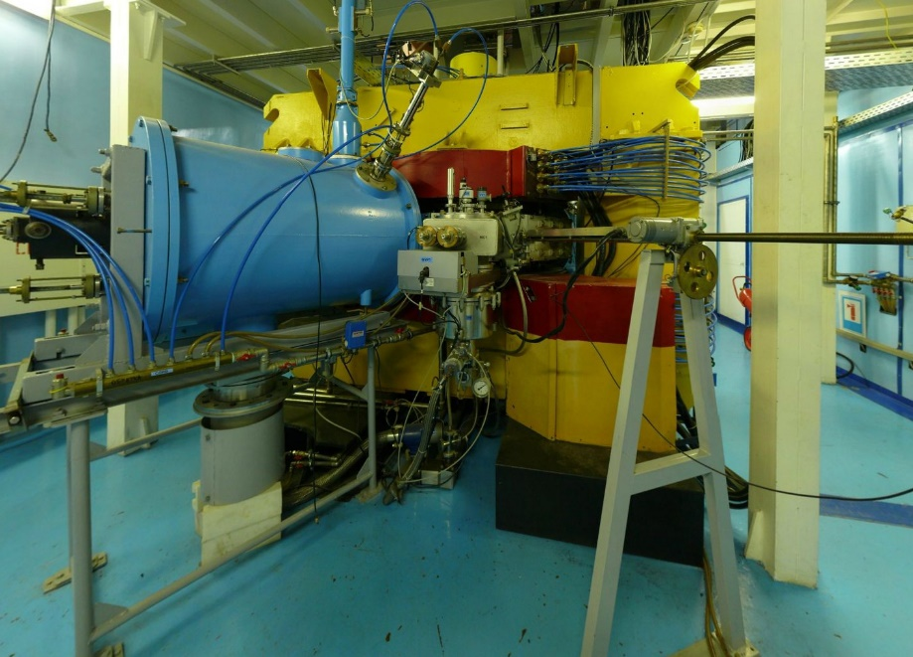
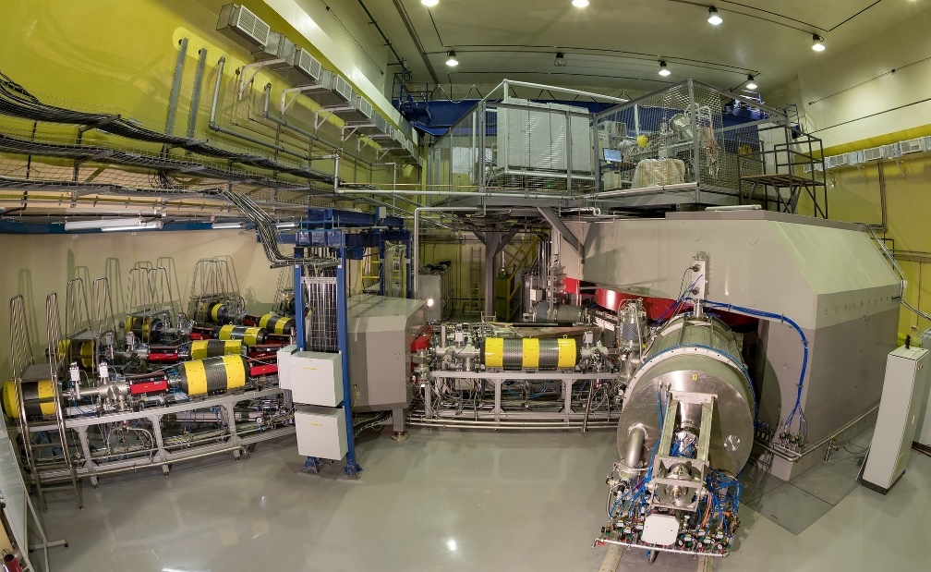
FLNR basic installations
U-400
U-400M
DC-280
IC-100

Slide 4
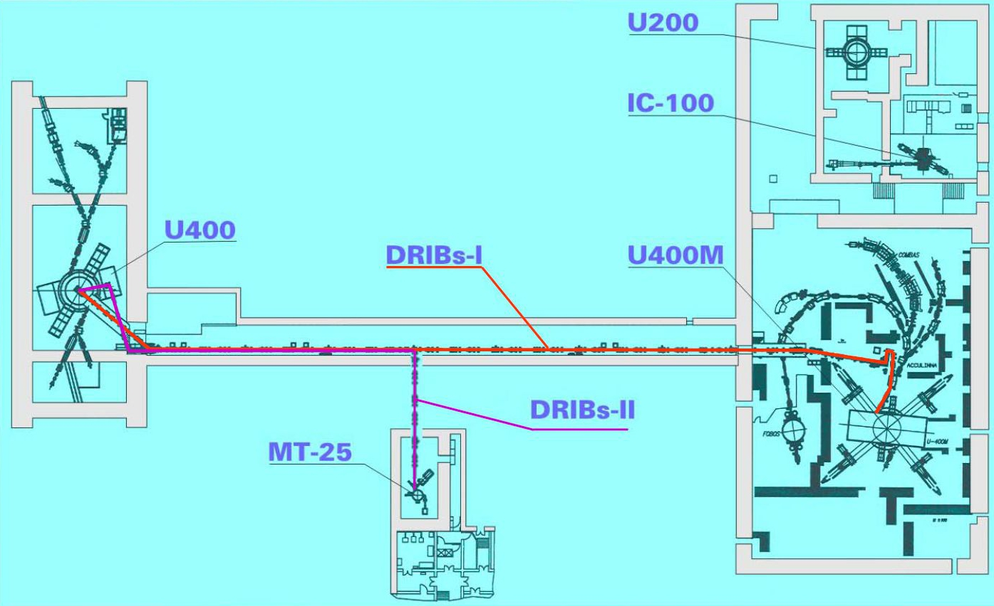
Special view

Slide 5
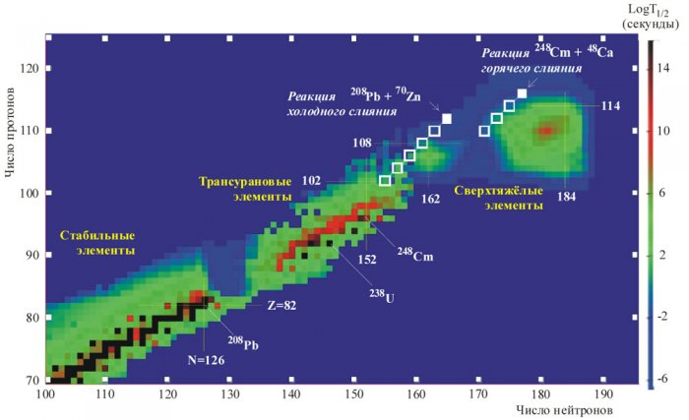
The stability map
Hot fusion reactions
Cold fusion reactions
Transuranium el. (Peninsula)
Super Heavy el.
(Island)
Stable elements
(Continent)

Slide 6

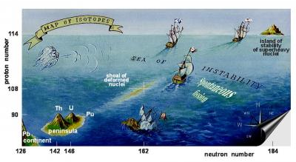
MASHA
Mass Analyzer of Super Heavy Atoms
“MASHA” at the beam line of the cyclotron U-400M, FLNR, JINR

Slide 7
Contents
The present status of the mass-spectrometer MASHA (Mass-Separator of Supper Heavy Atoms) designed for determination of the masses of superheavy elements.
Results of the test experiments on the mass-spectrometer MASHA aimed at the study of evaporation residua in the reactions ⁴⁰Ar+¹⁴⁴Sm and ⁴⁰Ar+¹⁶⁶Er.
Production and spectroscopic investigation of neutron-rich isotopes, produced in mutinucleon transfer reactions, near the neutron N = 126 and N=152 shell closures. Test experiments.
Determination of masses of super heavy elements in the experiments on synthesis of 112 and 114 elements by using the reactions ⁴⁸Ca+²³⁸U and ⁴⁸Ca+²⁴²Pu. The beam energy is E_{beam} ~ 5 MeV/n.

Slide 8
Mass
Analyzer of
Super
Heavy
Atoms
1 – Target box with hot catcher;
2 – Ion source;
3 – Mass separator;
4 – DAQ in the focal plane.
General ion-optical parameters:
Range of energy variation, keV 15-40
Range of Br variation, Tm 0.08-0.5
Mass acceptance, % +/-2.8
Angular acceptance, mrad +/-14
Diameter the ion source exit hole, mm 5.0
Horizontal magnification at F1/F2 0.39/0.68
Mass dispersion at F1/F2, mm/% 1.5/39.0
Linear mass resolution at F1 75
Mass resolution at F2 1300
The proposed setup is a combination of the so-called ISOL method of synthesis and separation of radioactive nuclei with the classical method of mass analysis, allowing mass identification of the synthesized nuclides in the wide mass range (A = 1-450 u).

Slide 9
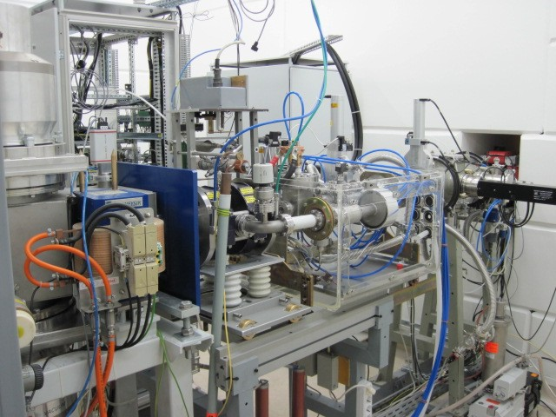
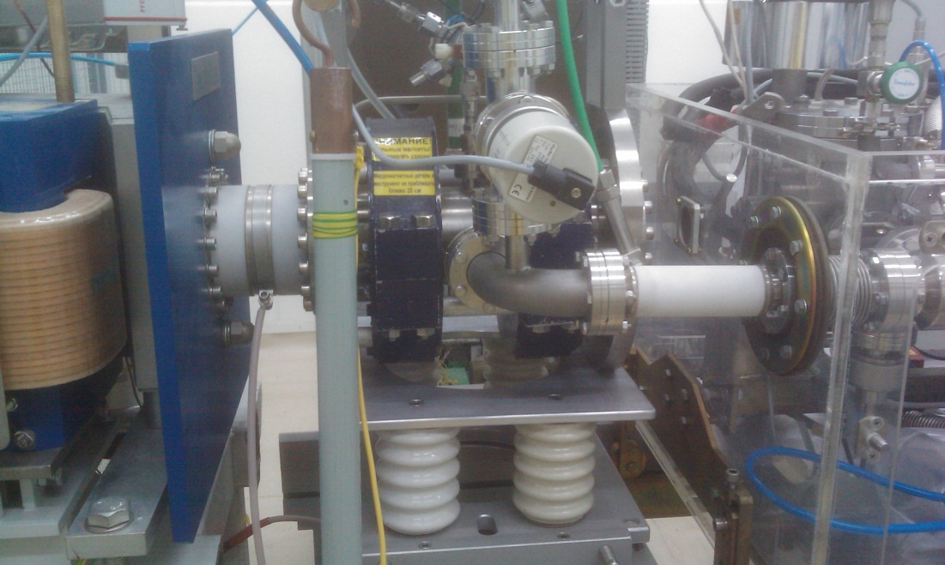
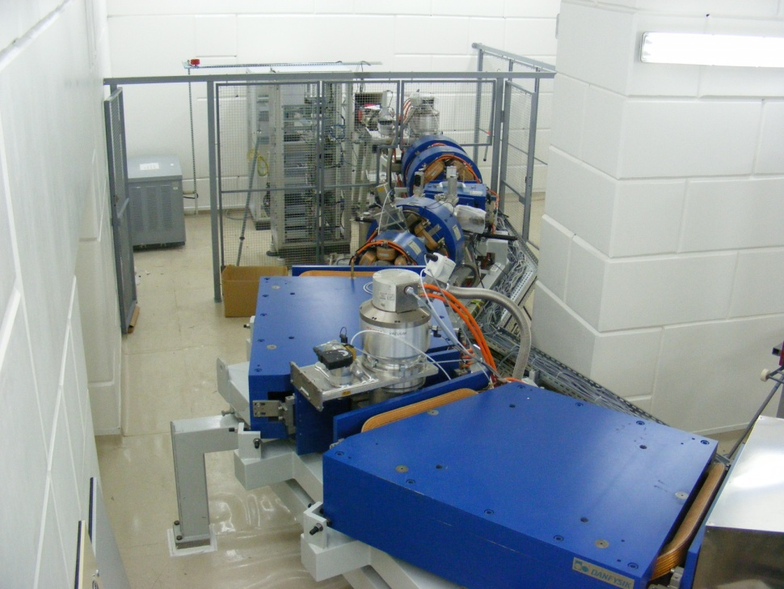
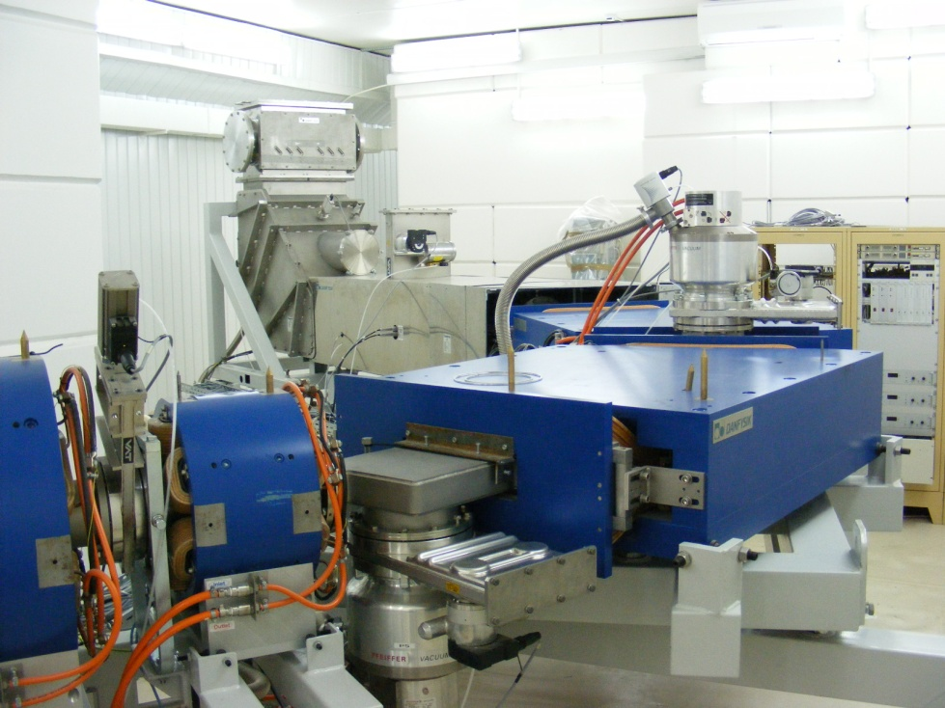

Slide 10
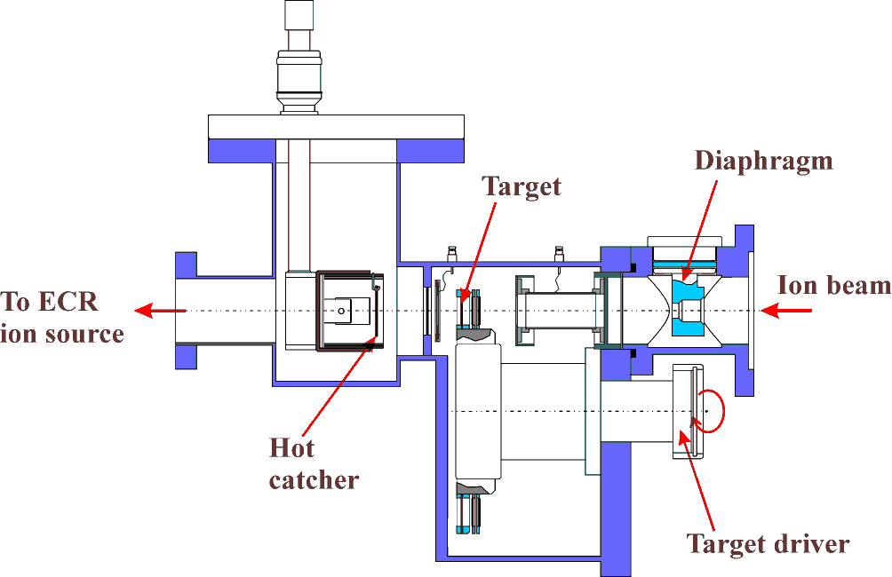
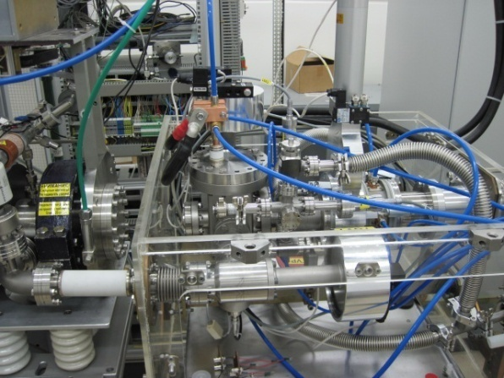
Hot catcher scheme
ECR
ion source
Hot catcher
Target
Beam line
Recoil transport
Material of the catcher – flexible graphite, density of 1 g/cm³,
a thickness of 0.6 mm and shaped as a 30 mm diameter disk.
Operating temperature of hot catcher – 1800-2000^{о}С.
Delivery time of nuclides to the ECR ion source < 1.8 s.

Slide 11
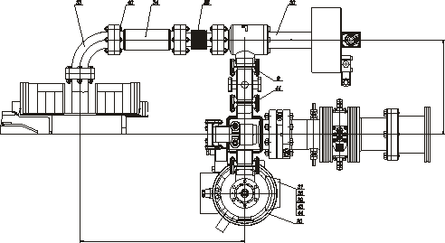
Ion source + Hot catcher (top view)
Nuclear reaction products escape from the target, pass through the separating foil, and are stopped in the graphite absorber. In the form of atoms, the products diffuse from the graphite absorber to the vacuum volume of the hot catcher and, moving over the pipeline, reach the ECR source, where are ionized to charge state Q = +1 and accelerated with the aid of the three electrode system.

Slide 12
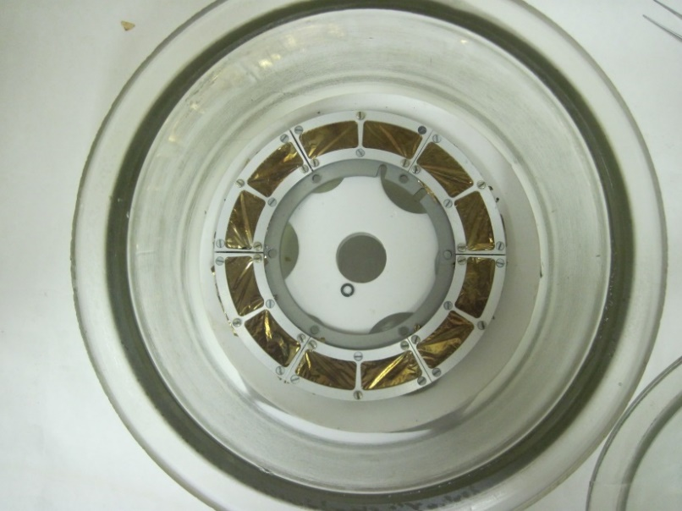
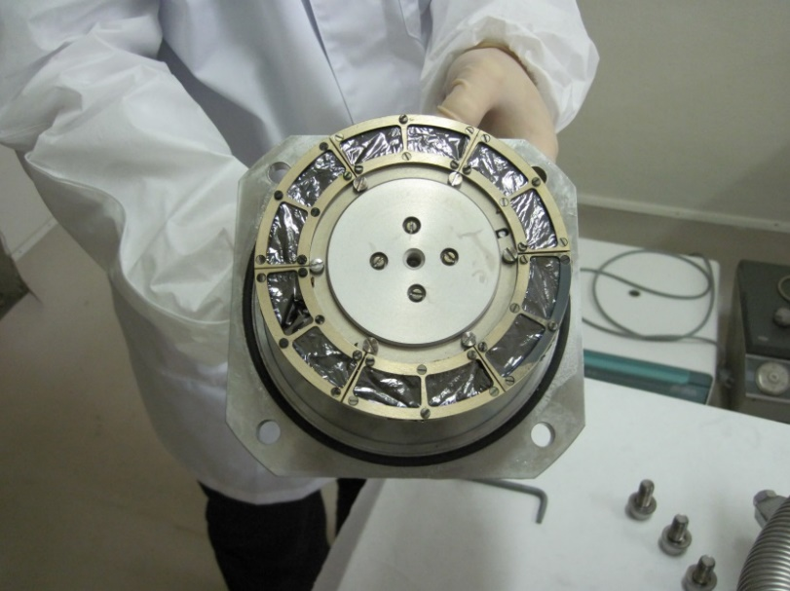
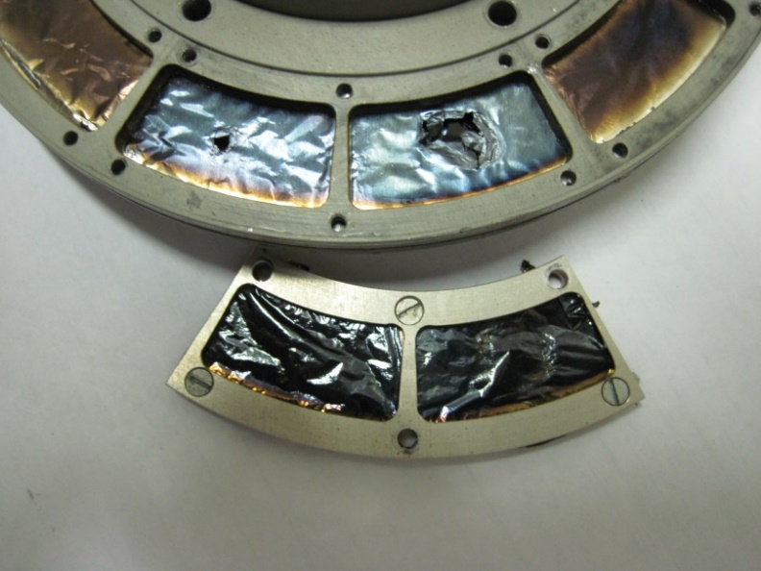
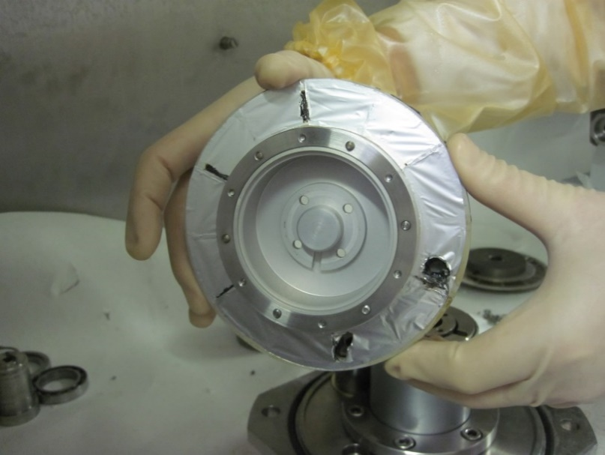
²⁴²Pu rotating target before and after irradiation

Slide 13
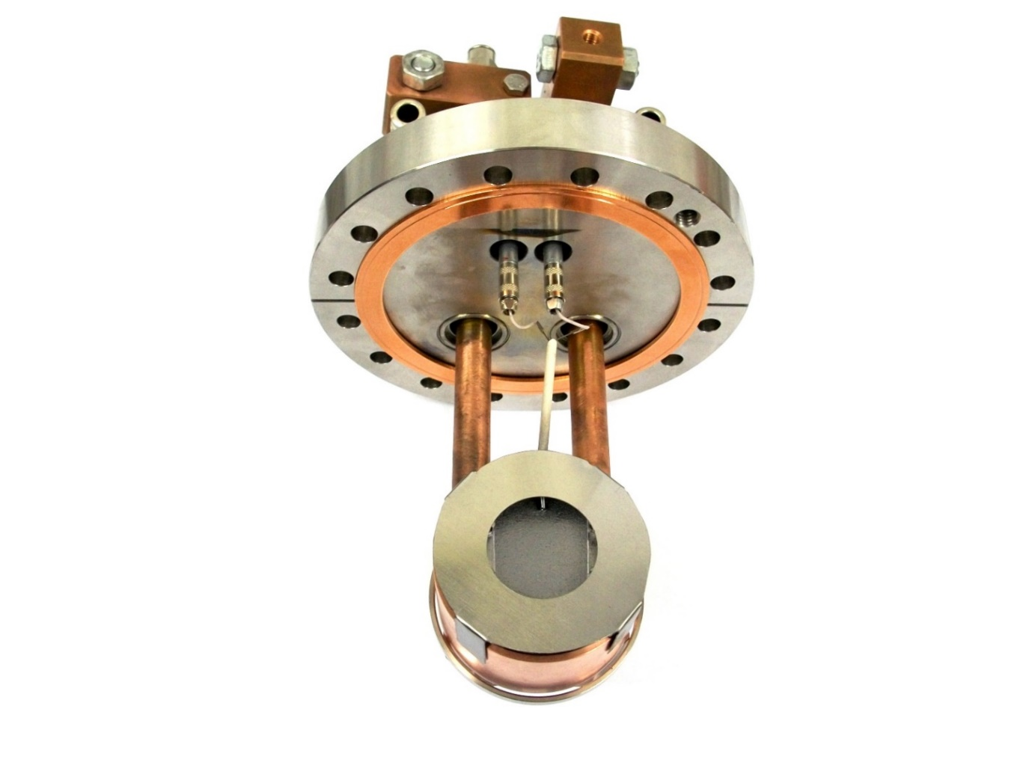
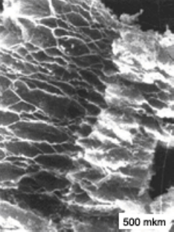
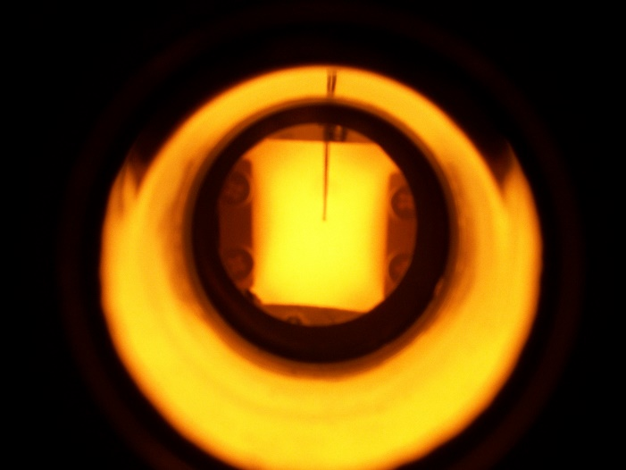
Hot Catcher
In assembly on a flange
Under microscope
Sheets
Heating up to 1800 ºC
Porosity coefficient – 75%

Slide 14
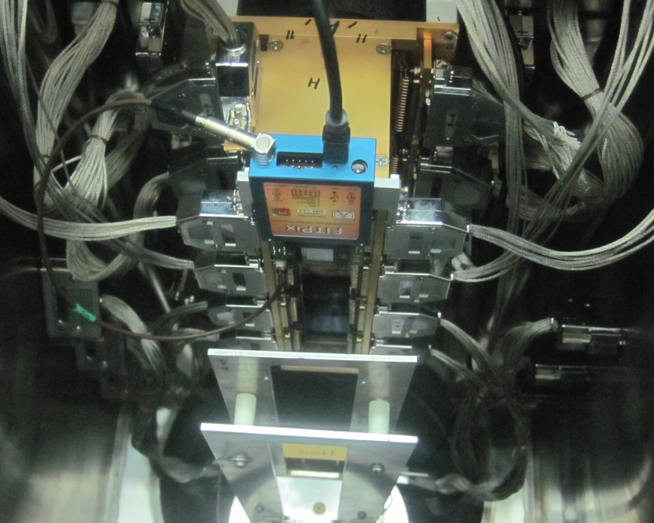
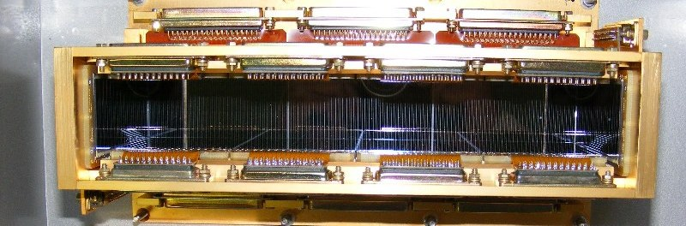
Focal plane silicon multi strip detector
TIMEPIX detector
Configuration – well type
Number of the focal strips – 192 (step – 1.25 mm)
Number of the back side strips – 160 (step – 5 mm)
Total efficiency – more than 90%
An array of 256x256 square pixels of pitch size 55μm for full sensitive area 14x14 mm². Silicon sensor of 300 μm width.

Slide 15
Data acquisition system
22 charge-sensitive preamplifier, 16 channels.
22 multiplexers-amplifiers designed at FLNR JINR.
5 digitizers from XIA (PXI standard), 16 channels, 250 MHz, 12-bits.
Energy resolution ~ 25 keV.
After amplification and multiplexing, three outputs from the multiplexer are used: alpha, fragment, and digital channels. The digital channel includes the information on the source of the input signal. These outputs are connected to the XIA multichannel high-speed digitizers.

Slide 16
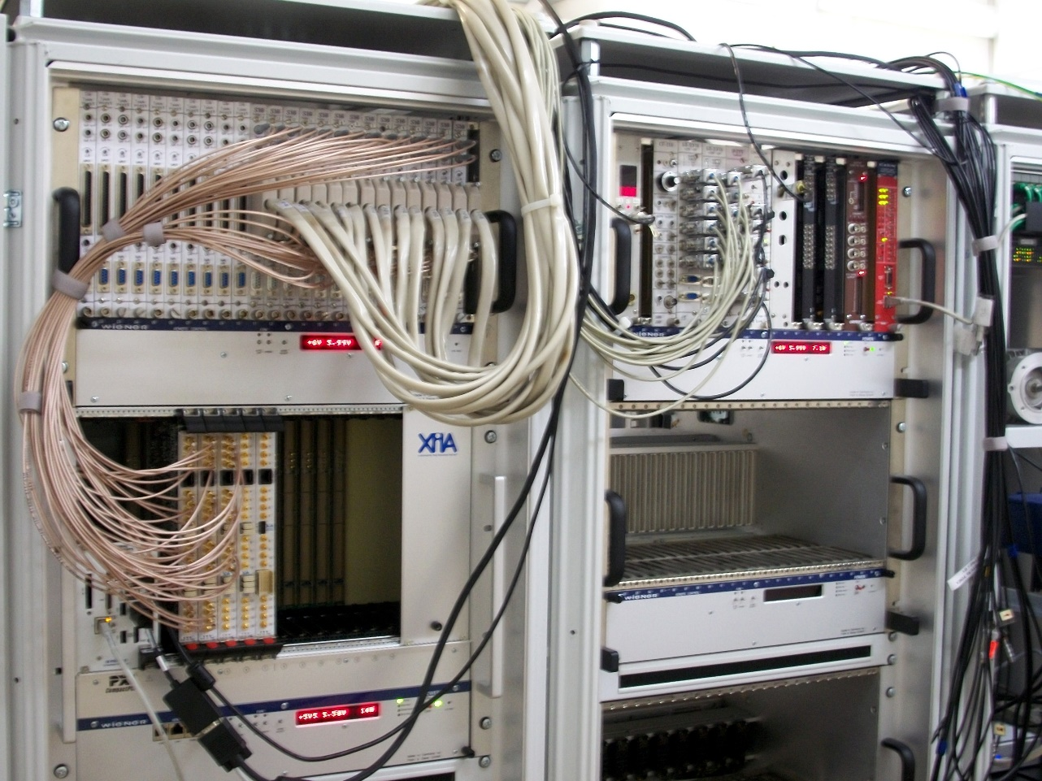
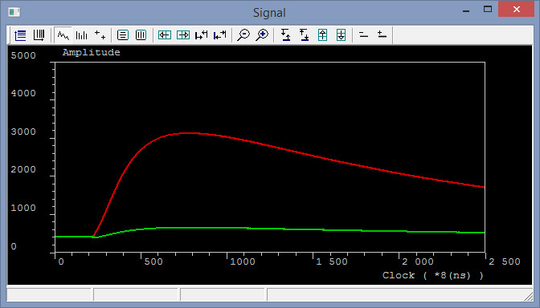
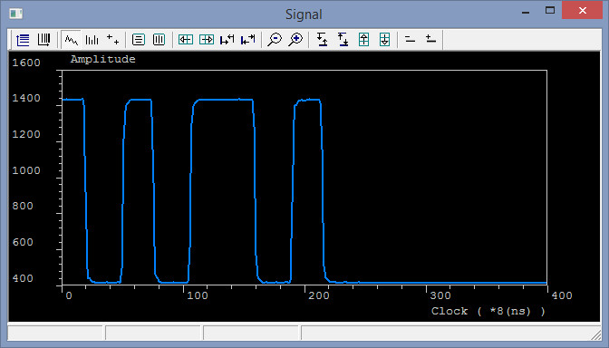
PXI chassis with XIA digitizers, NI controller and crate with multiplexors (left photo). Examples of signals from one strip (right pictures).

Slide 17
Energy measurement
TOF method
Directly:
By help of 2 pick-up detectors with 2 pre-amplifiers designed at FLNR, JINR.
Using scatterring beam on gold foil (45º):
With the aid of 2 MCP detectors, distance - 1210 mm work as a Time-of –Flight and 1 latter Silicon detector work as TKE.
Electronics: (PXI standard)
2 High-speed digitizers from Agilent, 2 channels, 2 GHz, 10-bits.
2 TDC from Agilent, 5 ps resolution, 12 channels.

Slide 18
First test experiments
⁴⁰Ar+¹⁴⁴Sm -> Hg, E_{beam} = 5-7 MeV/n
⁴⁰Ar+¹⁶⁶Er -> Rn, E_{beam} = 5-7 MeV/n
⁴⁰Ar⁵⁺, current ~ 100 pnA

Slide 21
⁴⁰Ar+¹⁴⁴Sm→^{184-xn}Hg

Slide 22
⁴⁰Ar+¹⁶⁶Er→^{166-xn}Rn

Slide 23
Theoretical calculations, coupling channel model

Slide 24
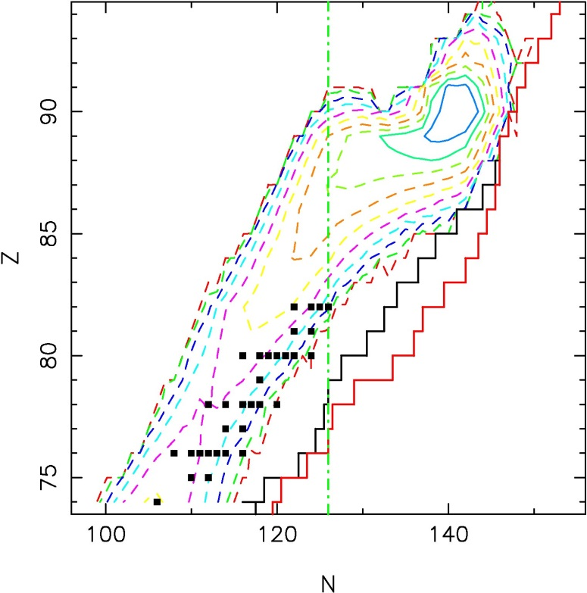
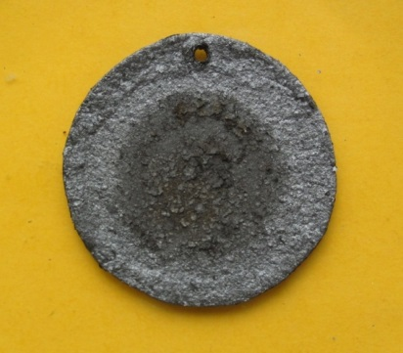
Multi nucleon transfer reactions
The composite target ²³²Th was used in the experiments. An alcohol solution of thorium nitrate was deposited into flexible graphite (thickness = 0.6 mm) and annealed at the temperature 1900°C. Finally target as ThO₂ was made and bombarded by beam of ⁴⁸Ca with energy Ebeam = 7.3 MeV/nucl.
Calculation for ⁴⁸Ca+²³²Th
at the energy 370 MeV
Composed target
²³²Th + graphite

Slide 25
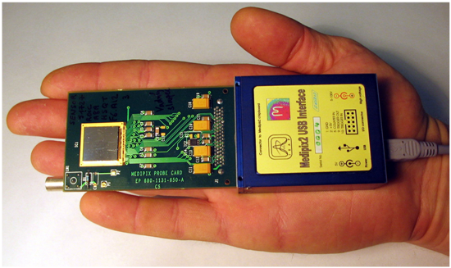
Test experiments on production of Rn and Hg isotopes in the multi nucleon transfer reactions by using the TIMEPIX detector
This camera operates as an active nuclear emulsion enabling the detection of heavy charged particles, such as fission fragments, and α-particles, β-particles, X and γ -rays in a wide linear dynamic range.

Slide 26
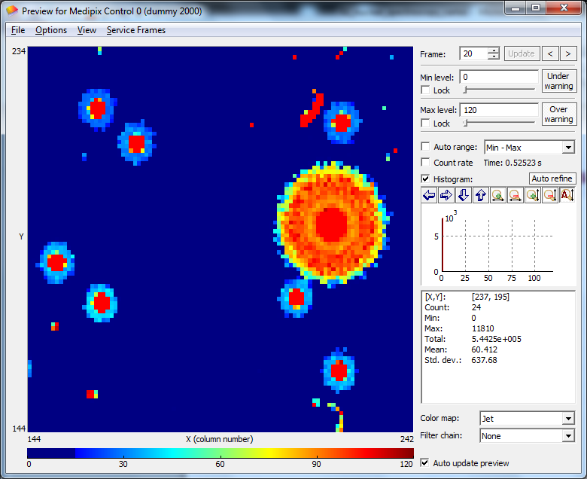
Timepix: HCP’s: α’s, fission fragments

Slide 27
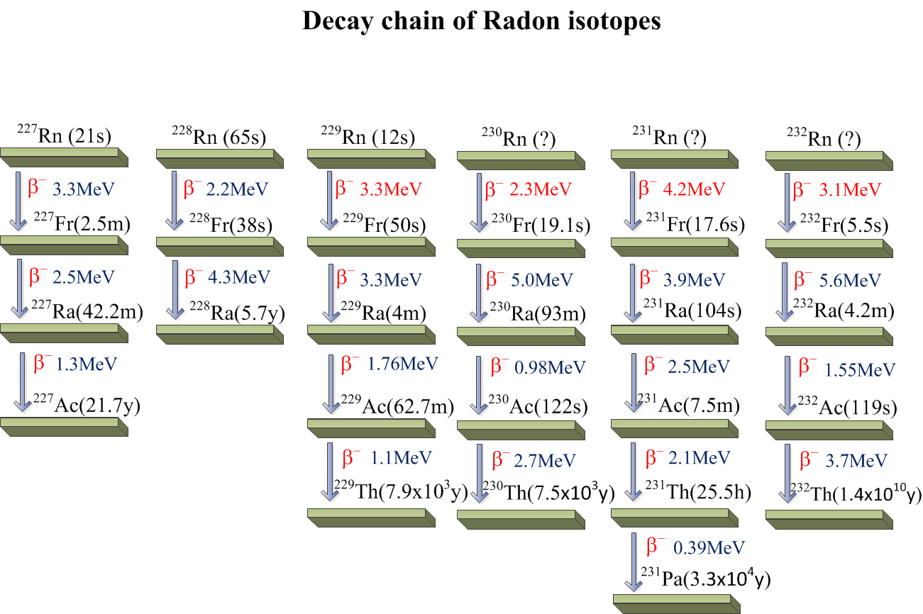

Slide 28
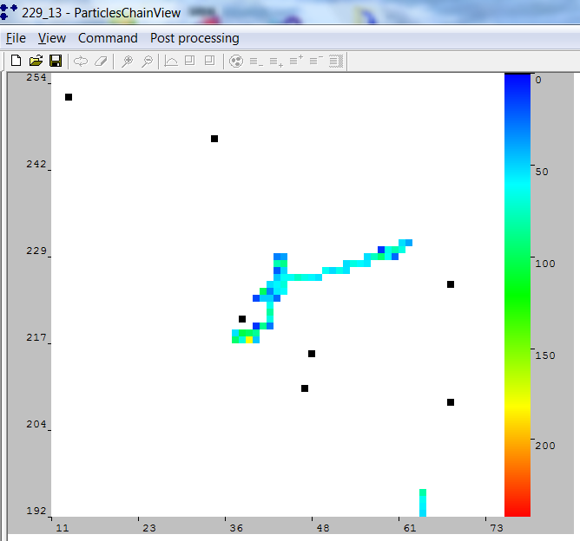
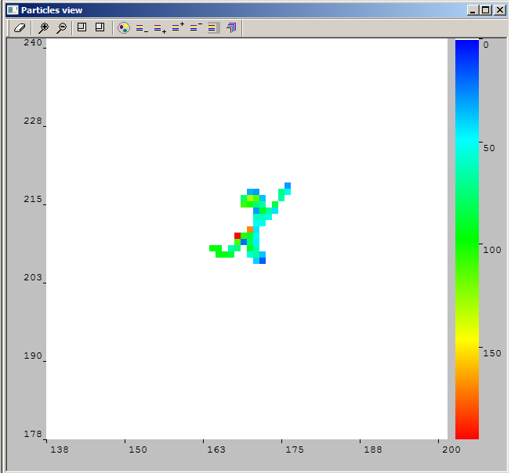
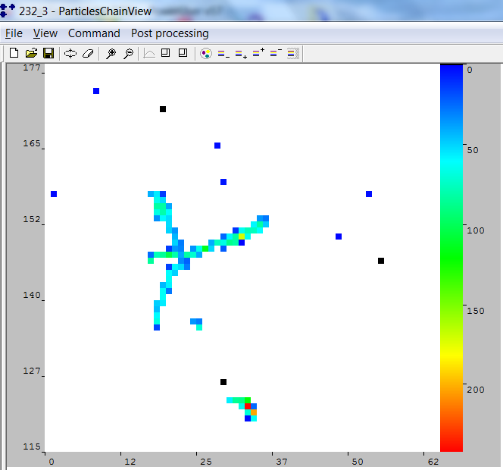
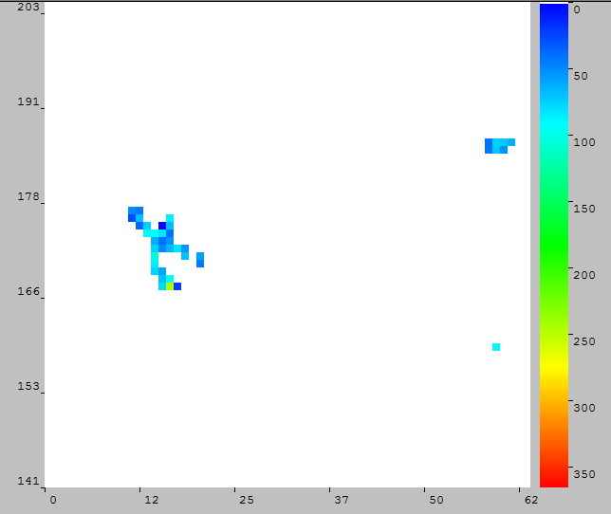
Radon isotopes
²²⁹Rn
²³⁰Rn
²³¹Rn
²³²Rn

Slide 29
Thank you for attention

